Slide 1
Moral Lenses case study
Notes:
Facebook "meaningful social interactions" ranking change
This case study was drawn from WSJ Facebook Files podcast, part 4: the Outrage Algorithm:
https://www.wsj.com/podcasts/the-journal/the-facebook-files-part-4-the-outrage-algorithm/e619fbb7-43b0-485b-877f-18a98ffa773f

Slide 2
Warmup
Read the problem and the proposed design change
With your partner, brainstorm:
differences that might happen as a result
stakeholders affected by or interested in those differences
Write your answers in case-study.txt
Notes:
some possible **differences**
+ increased engagement -- more comments, reactions, likes
+ people feel stronger social connection to their friends
+ people change their posts to get reactions
+ influencers need to broaden their social networks in order to get higher uptake
+ velocity of information increases (more resharing)
+ people see more updates from family & friends, less news from mainstream media outlets
some possible **players**
+ FB employees
+ FB users
+ FB shareholders
+ advertisers
+ competitors (e.g. Twitter, LinkedIn)
+ media and PR people
+ subjects of viral FB discussions (celebrities, public figures, cancel victims)
+ elected politicians
+ government officials
+ healthcare workers (e.g. Covid denial or vaccine disinformation)

Slide 3
Moral Lenses review
What are the three moral lenses?
let’s imagine them in the context of a game show
Notes:
Get at least the main 3 lenses on the board, and offer another mental model: game shows
+ Outcomes: what's the prize at the end: winner gets a million bucks? or all the losers die?
+ Process: is the experience of playing the game degrading or unpleasant (trash TV)? or are you enjoying it (maybe singing or showing your knowledge)?
+ Structure: how are outcomes or processes distributed? Is the game fair, or is it biased against certain kinds of players? College educated. People with enormous upper body strength.

Slide 4
Facebook in 2017
Problem: people are still using FB, but more passively
reading posts and watching videos, but not commenting or liking as much as before
"We have an ethical duty not to turn Facebook users into zombies"
Proposal: rank posts by meaningful social interaction (MSI)
MSI = actions on a post (comment >> react-emoji/reshare >> like) made by your own friends
With your partner:
apply the moral lenses for the stakeholder group of your section of the room
write your answers in case-study.txt
Working with the other pairs in your section:
put your Outcomes/Process/Structure points in the slides
consolidate similar points
vote for 1-2 points per slide (e.g. important or nonobvious)
boldface those key points
Notes:
The quote (“We have an ethical duty...”) comes from a FB employee speaking in an internal FB training video around that time (cited in WSJ Facebook Files podcast, part 4: the Outrage Algorithm)
Divide the room into 5-6 sections, and assign one stakeholder group to each section. Probably aim for these (which hopefully are already on the board from the warmup discussion):
+ FB users
+ FB shareholders
+ advertisers
+ media, influencers, PR people
+ subjects of viral FB discussions (celebrities, public figures, cancel victims)
Students work in pairs for 10 minutes, thinking just about their stakeholder group with respect to the 4 lenses.
Then come together as groups, in a Google Slide doc for each group (using google-slides-template.pptx and allowing anonymous editing), to consolidate their points for 10 minutes.
Instructor then cherry-picks some slides from some groups (don't have time to do 3 lenses * 5 groups) and asks students to discuss highlighted points.
Some possible insights:
Outcomes
+ (FB users) more happiness because they are seeing what their friends are doing and caring about
+ (FB shareholders) higher share price because people are still on FB and happy about it
+ (PR people or press) less spread of their content Process
+ (media/influencers) have to work harder to broaden their social networks and encourage
+ (FB users) experience more posts from their highly-active friends -- so maybe more political posts?
+ (celebrities)
Structure
+ (media) mainstream media might experience slower velocity, while extremist media experiences higher velocity

Slide 5
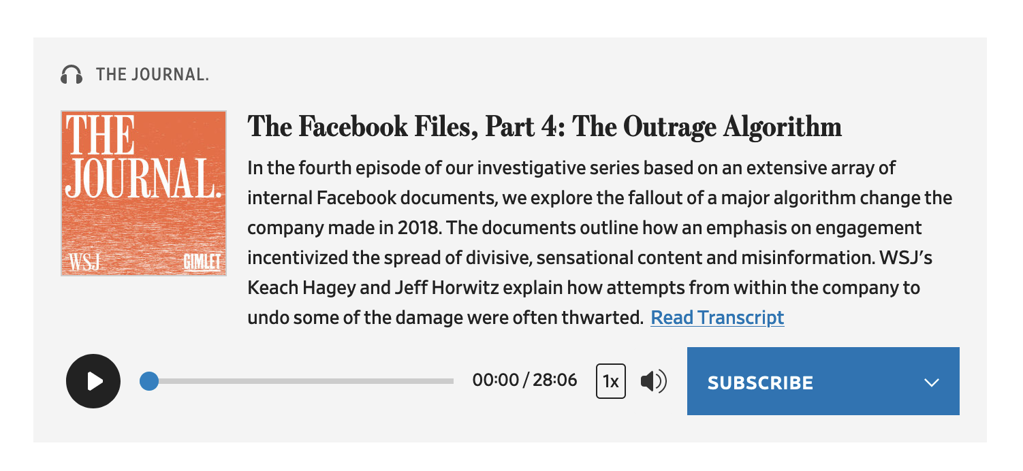
Action
After moral lens analysis, what do we have that we may not have had before?
What can we do with that new knowledge?
For more about this case study:
Wall Street Journal Facebook Files podcast series
© WSJ. All rights reserved. This content is excluded from our Creative Commons license. For more information, see https://ocw.mit.edu/help/faq-fair-use/
Notes:
What actually happened as a result of this change?
+ Engagement did increase
+ User happiness fell -- people were seeing more upsetting things in their feeds
+ Strong reaction-emojis got higher weight
+ Velocity of misinformation and hate speech increased
+ Heavy activity by a weak tie with strong views would be promoted
Why this case study?
+ Example of a well-intentioned change made by well-meaning engineers to support their values, even if there are players and differences they haven't considered or addressed, or unforeseen consequences.
+ Remember to iterate!

Slide 6
MIT OpenCourseWare
https://ocw.mit.edu/
RES.TLL-008 Social and Ethical Responsibilities of Computing (SERC)
Fall 2022
For information about citing these materials or our Terms of Use, visit: https://
ocw.mit.edu/terms

